Slide 1
A NOVEL SIDE FACE CONTOUR EXTRACTION ALGORITHM FOR DRIVING FATIGUE STATUE RECOGNITION

Slide 2
ABSTRACT
Fatigued driving detection, pattern recognition to discover the state of fatigue, is considered a key technique to improve road safety.
The widely used frontal face recognition systems have problems, such as low recognition accuracy, poor real-time ability, and highly complex algorithms.
A new color space modeling, which uses multi-threshold decision criteria is used to enhance facial skin extraction performance, and a three-step strategy is designed to eliminate noise and other adverse effects.
It can extract side face contour lines effectively and provide a scientific basis for real-time tracking of fatigue.

Slide 3
OBJECTIVES
To improve road safety.
Enhance the skin Extraction performance.
To detect fatigued driving

Slide 4
DOMAIN INTRODUCTION
Digital image processing is the use of computer algorithms to create, process, communicate, and display digital images. Digital image processing algorithms can be used to:
Convert signals from an image sensor into digital images
Improve clarity, and remove noise and other artefacts
Extract the size, scale, or number of objects in a scene
Prepare images for display or printing
Compress images for communication across a network

Slide 5
PROCESS INTRODUCTION
Facial recognition system
A facial recognition system is a computer application capable of identifying or verifying a person from a digital images.
Contour Line
A contour line of a function of two variables is a curve along which the function has a constant value, so that the curve joins points of equal value.
Color Model
A color model is an abstract mathematical model describing the way colors can be represented as tuples of numbers, typically as three or four values or color components.

Slide 6
EXISTING SYSTEM
Frontal Face Detection
It identifies human faces in digital images. Face detection also refers to the psychological process by which humans locate and attend to faces in a visual scene.
Side Contour Extraction
The points at which image brightness changes sharply are typically organized into a set of curved line segments termed edges. Edge detection is a fundamental tool in image processing, machine vision and computer vision, particularly in the areas of feature detection and feature extraction.

Slide 7
DISADVANTAGES
We can only use the digital images.
We can’t detect the accurate portion of image.
To contour line extraction, we use the edge detection techniques.

Slide 8
PROPOSED SYSTEM
Proposed system based face detection method in which a three-layer system is defined to fulfill feature filtering equalization and ruler detection.
Skin Color Modeling
Skin color modeling is the core step for side face region extraction. As the basis for model establishment, color space should be selected first. In this paper, the YUV and YIQ color spaces are used. Multiple threshold values criterion is used to construct the skin color model.
Noise Removal
It removes noise and sharpens the image to provide a better initial condition for the subsequent processing. An object out of focus results in a blurred image.

Slide 9
ADVANTAGES
Face detection, which detects the presence and subsequently the position of a face.
Three-step strategy is more accurate than face recognition algorithms.
Side face contour detection focuses on the relationship between facial profile and driver fatigue

Slide 10
SYSTEM REQUIREMENTS

Slide 11
SOFTWARE REQUIREMENTS
O/S : Windows 7.
Language : MATLAB 2013a
HARDWARE REQUIREMENTS
System : Intel Core
Hard Disk : 160 GB
Ram : 4GB

Slide 12
DATA FLOW DIAGRAM
Start
Validation
Read an Image
Facial Contour Extraction
No
Select correct type of Image
Load a Dataset
Contour Line Extraction
Yes
Color correction
Corrosion & Expansion
Face Correction
Extract RGB components
Reconstruct Images
Skin Color Detection
Calculate Threshold Value

Slide 13
BLOCK DIAGRAM
Read an Image
Validation
imread()
Evaluate
Basic Extraction
Facial Contour Image
Corrosion & Expansion
Color correction
Line Extraction
Side Face Extraction
Facial Contour Extraction
Skin Color Modelling

Slide 14
SEQUENCE DIAGRAM
Read an Image
Basic Extraction
Side Face Extraction
Facial Contour Extraction
Validation
imread()
Color correction
Extract RGB components
Reconstruct Images
Skin Color Modelling
Corrosion & Expansion
Contour Line Extraction
Calculate Threshold Value
Evaluate

Slide 15
USE CASE DIAGRAM
Read an Image
Basic Extraction
Input
Face Correction
Contour Line Extraction
Validation

Slide 16
MODULES
Read an Image
Basic Extraction
Side Face Extraction
Facial contour Extraction
Validation

Slide 17
MODULE DESCRIPTION

Slide 18
READ AN IMAGE
In our process we have to load a hyper-spectral dataset to process.
First, we group a hyper spectral images into dataset.
We can select the any of the image from the dataset. It can be possible by the use of uigetfile () function.
It has two parameters, these are type of file and message.
If we use ‘*.*’ for the type of file, we can select any type of file at runtime. If we use this type it displayed all type of files.

Slide 19
READ AN IMAGE - FLOW
Load a Dataset
Pick a file
No
Select a correct type
Yes
Go to Extraction

Slide 20
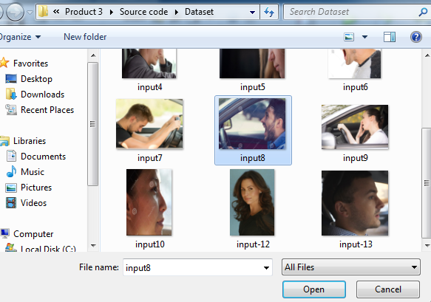
READ AN IMAGE

Slide 21
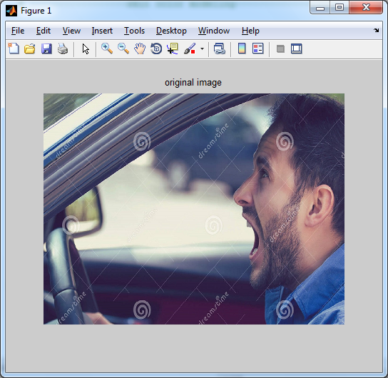
ORIGINAL IMAGE

Slide 22
BASIC EXTRACTION
The goal of side face extraction is to obtain a side face contour line.
Color Correction
The mean values of the three components of the RGB in the image are similar to the same gray value, and they are limited in the range of [0 to 255] so that the adjustment of the RGB image of the three components is close to A aver .To reduce the impact of illumination, a color correction procedure is the first step of the proposed.
Skin Color Modeling
Skin color modeling is the core step for side face region extraction. As the basis for model establishment, color space should be selected first. YUV and YIQ color spaces are used. Multiple threshold values criterion is used to construct the skin color model.

Slide 23
BASIC EXTRACTION - FLOW
Calculate Mean value
Skin Color Modelling
Extract RGB components
Pixel set to 0
Threshold range to meet the R>G>B
Pixel set to 1
No
Yes
Calculate co-efficient of RGB
Re-Build an Images
Reconstruct Images
RGB=> YUV & YIQ
Calculate Threshold Value

Slide 24
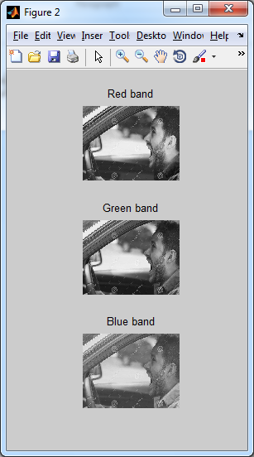
RGB COMPONENTS

Slide 25
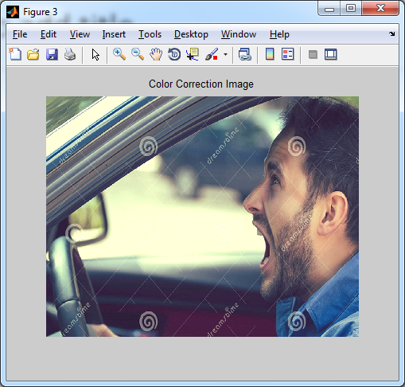
COLOR CORRECTION IMAGE

Slide 26
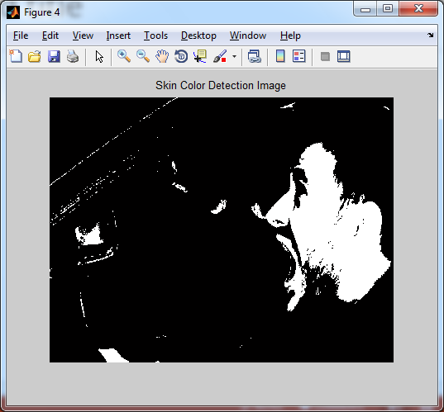
SKIN COLOR DETECTION IMAGE

Slide 27
SIDE FACE EXTRACTION
Skin color modeling method is used to separate skin areas from a complex background.
It include some non-skin points, which are considered noise and should be removed by further processing.
The approaches for noise removal include a texture-based method and a mathematical morphology-based method.
Two processes are performed.
Corrosion
Expansion

Slide 28
SIDE FACE EXTRACTION - FLOW
Skin color region
YCrCB threshold segmentation
Maximum area preservation
Corrosion and Expansion
Edge detection
Contour original image
Imoverlay()

Slide 29
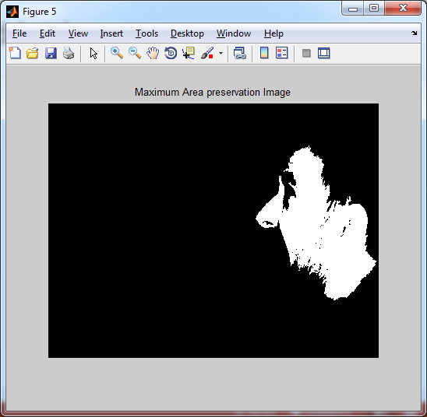
MAXIMUM AREA PRESERVATION

Slide 30
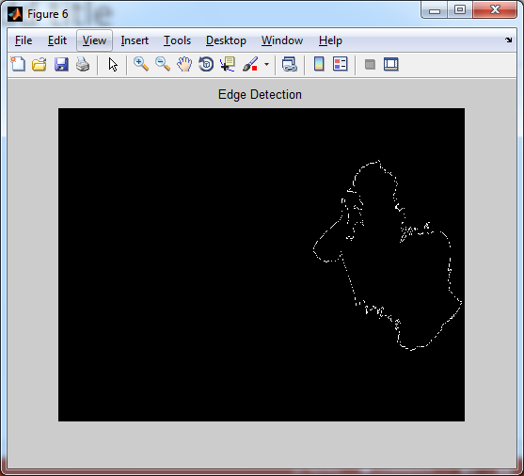
EDGE DETECTION

Slide 31
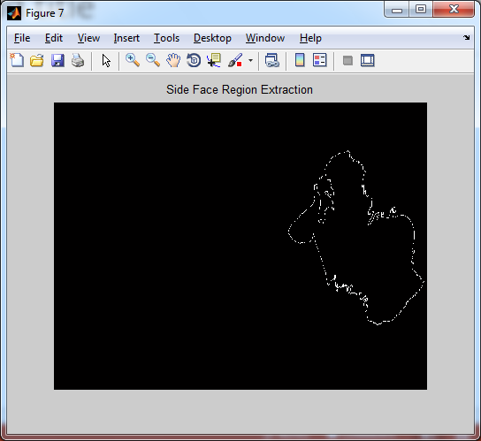
SIDE FACE REGION EXTRACTION

Slide 32
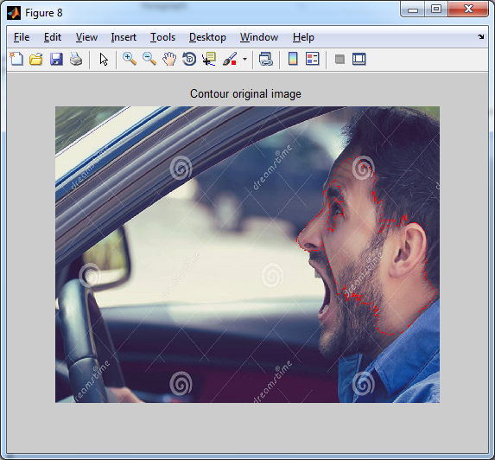
CONTOUR ORIGINAL IMAGE

Slide 33
FACIAL CONTOUR EXTRACTION
After precisely positioning the side face region, the face contour line extract process is performed.
Find the position of the first white pixel near the upper left corner of the middle position of the image. Set it as the starting point of the boundary.
Search for each contour point from the starting in a clockwise direction by a pre-defined 8-neighborhood matrix until return to the starting point.
Record the coordinates that have been found for each point of the boundary to a chain table in the order of the search.
The coordinate information stored in the chain table is extracted and connected in order, and the profile curve of the target is obtained.

Slide 34
FACIAL CONTOUR EXTRACTION - FLOW
Facial region
Search Contour point
Facial line extraction

Slide 35
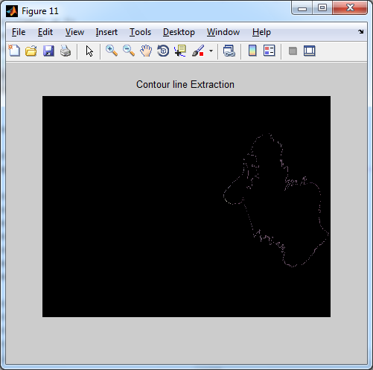
CONTOUR LINE EXTRACTION

Slide 36
VALIDATION
Classification models in machine learning are evaluated for their performance by common performance measures.
Mean-Class Accuracy:
Is obtained averaging the accuracies achieved in each of the classes. It is a more reliable measure than the overall accuracy when, as in this case, the sample distributions for the same classes are limited in number, causing an unbalanced dataset.
Sensitivity:
Is the proportion of actual positives which are correctly identiﬁed as positives by the classiﬁer.
Speciﬁcity:
Is the proportion of the actual negatives which the classiﬁer successfully identiﬁes as negative.

Slide 37
VALIDATION (CONT…)
Precision
Is the number of true positives (i.e. the number of items correctly labeled as belonging to the positive class) divided by the total number of elements labeled as belonging to the positive class (i.e. the sum of true positives and false positives, which are items incorrectly labeled as belonging to the class).
Recall
Recall in this context is defined as the number of true positives divided by the total number of elements that actually belong to the positive class. Recall is the fraction of the documents that are relevant to the query that are successfully retrieved.

Slide 38
VALIDATION CONT…
F-Measure
A measure that combines precision and recall is the harmonic mean of precision and recall, the traditional F-measure or balanced F-score. F-measure can be a better single metric when compared to precision and recall; both precision and recall give different information that can complement each other when combined.
GMean (Geometric Mean)
The geometric mean is a type of mean or average, which indicates the central tendency or typical value of a set of numbers by using the product of their values.

Slide 39
VALIDATION - FLOW
Accuracy
Sensitivity
Original binary image
Specificity
Evaluate
Performance
Precision
Facial extracted binary image
Recall
F-measure
G-Mean

Slide 40
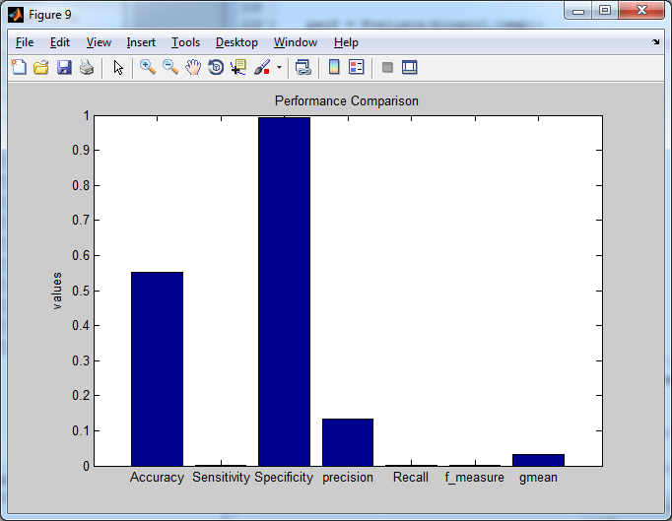
PERFORMANCE COMPARISON – BAR CHART

Slide 41
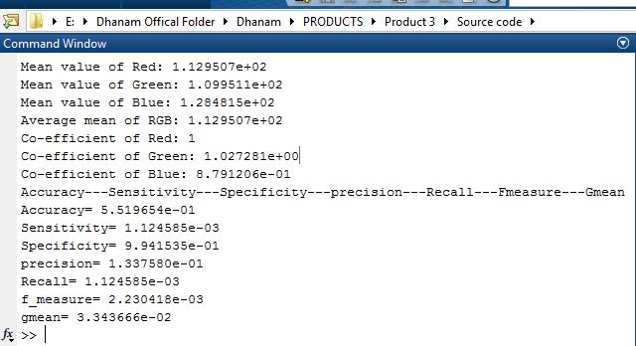
VALIDATION

Slide 42
LITERATURE SURVEY

Slide 43
Title | Authors | Methodology | Merits | Demerits
Were they in the loop during automated driving? Links between visual Attention and crash potential | T. Louw et al | vehicle automation is that it relieves drivers from the moment-to-moment demands of driving, to engage in other, non-driving related, tasks. However, it is important to gain an understanding of drivers’ capacity to resume manual control, should such a need arise. | Resolved within one second and visual attention allocation adapted with repeated events | We did not demonstrated a more stable pattern.

Slide 44
Title | Authors | Methodology | Merits | Demerits
Semantic-based facial expression recognition using analytical hierarchy Process,” Expert Syst. Appl. | S. C. Cheng, M. Y. Chen, H. Y. Chang, and T. C. Chou | We present an automatic facial expression recognition system that utilizes a semantic-based learning algorithm using the analytical hierarchy process (AHP). All the automatic facial expression recognition methods are similar in that they first extract some low-level features from the images or video, then these features are used as inputs into a classification system, and the outcome is one of the preselected emotion categories. | evaluate the fitness of a semantic description for interpreting the emotion of a face image. | facial expression recognition results obtained in terms of low-level features and high-level semantic description is small.

Slide 45
Title | Authors | Methodology | Merits | Demerits
Illumination invariant face recognition using near-infrared images | S. Z. Li, R. Chu, S. Liao, and L. Zhang | It presents a comprehensive survey of LBP methodology, including several more recent variations. As a typical application of the LBP approach, LBP-based facial image analysis is extensively reviewed, while its successful extensions, which deal with various tasks of facial image analysis, are also highlighted. | Efficiently summarizes the local structures of images. Efficiently comparing each pixel with its neighboring pixels. | Extensively exploited in many applications

Slide 46
Title | Authors | Methodology | Merits | Demerits
Detecting faces in images: A survey | M.-H. Yang, D. Kriegman, and N. Ahuja | Images containing faces are essential to intelligent vision-based human-computer interaction, and research efforts in face processing include face recognition, face tracking, pose estimation and expression recognition. However, many reported methods assume that the faces in an image or an image sequence have been identified and localized. | Dsetect faces in a single image, categorize and evaluate algorithms. | Robust and efficient face detection algorithms are required.

Slide 47
Title | Authors | Methodology | Merits | Demerits
A performance evaluation of local descriptors,'' IEEE Trans. Pattern Anal. Mach. Intel. | K. Mikolajczyk and C. Schmid | Local photometric descriptors computed for interest regions have proven to be very successful in applications such as wide baseline matching, object recognition, texture recognition, image retrieval, robot localization, video data min in, building panoramas, and recognition of object categories. | show the best performance among the low dimensional descriptors | Invariant to image transformations

Slide 48
CONCLUSION
The current number of traffic accidents and the many disadvantages of facial recognition algorithms, presents a method of facial profile extraction.
A three-step strategy is designed to extract side face contours, and a new human skin color model based on multi threshold combined decision is proposed.
A series of experiments are carried out to examine the performance of the proposed method. Three typical images, which are a close image with good lighting, a remote image with poor lighting and a close image with poor lighting, are selected to verify performance of the proposed multi threshold combined decision model.

Slide 49
FUTURE ENHANCEMENTS
Feature based methods are considered effective for frontal face recognition.
We are devoted to finding algorithms to distinguish facial features such as outline, eyes, nose, mouth, jaw, etc.
The face outline position is the first step of recognition.
A heuristic search method is used to revise the edge line.

Slide 50
REFERENCES

Slide 51
Q. Han, L. Zeng, L. Yang, and Y. Liu, ``Experimental analysis ofCCA threshold adjusting for vehicle EWM transmission in V-CPS,''Int. J. Ad Hoc Ubiquitous Comput., vol. 21, no. 1, pp. 1_6, 2016,injuryprev-2016-042155..
T. Louw et al., “Were they in the loop during automated driving? Linksbetween visual attention and crash potential,'' Injury Prevention, 2016.
F. S. C. Clement, A. Vashistha, and E. M Rane, ``Driver fatigue detectionsystem,'' in Proc. Int. Conf. Inf. Process., 2015, pp. 229_234.
B. Li, D. Zhang, and K. Wang, ``Online signature veri_cation based onnull component analysis and principal component analysis,'' Pattern Anal.Appl., vol. 8, pp. 345_356, Oct. 2006.
N. Rajput, P. Jain, and S. Shrivastava, Face Detection Using HMM_SVMMethod. Berlin, Germany: Springer, 2012.

Slide 52
S. Z. Li, R. Chu, S. Liao, and L. Zhang, ``Illumination invariant facerecognition using near-infrared images,'' IEEE Trans. Pattern Anal. Mach.Intell., vol. 29, no. 4, pp. 627_639, Apr. 2007.
Ross and A. Jain, ``Information fusion in biometrics,'' Pattern Recognit.Lett., vol. 24, no. 13, pp. 2115_2125, 2003.
M.-H. Yang, D. Kriegman, and N. Ahuja, ``Detecting faces in images:A survey,'' IEEE Trans. Pattern Anal. Mach. Intell., vol. 24, no. 1,pp. 34_58, Jan. 2002.
K. Mikolajczyk and C. Schmid, ``A performance evaluation of localdescriptors,'' IEEE Trans. Pattern Anal. Mach. Intell., vol. 27, no. 10,pp. 1615_1630, Oct. 2005.
J. Wu and Z. H. Zhou, ``Ef_cient face candidates selector for face detection,''Pattern Recognit., vol. 36, pp. 1175_1186, Jun. 2003.

Slide 53
L. Breiman, J. H. Friedman, R. Olshen, and C. J. Stone, ``Classi_cationand regression trees,'' Biometrics, vol. 40, pp. 17_23, Jun. 2015.
G. Hemalatha and C. P. Sumathi, ``A study of techniques for facial detectionand expression classi_cation,'' Int. J. Comput. Sci. Eng. Survey, vol. 5,pp. 27_37, Apr. 2014.
T. Kohonen, ``Self-organization and associativememory,'' Appl. Opt.,vol. 8, pp. 3406_3409, Oct. 2015.[14] A. Mohan, C. Papageorgiou, and T. Poggio, “Example-based object detection in images by components,'' IEEE Trans. Pattern Anal. Mach. Intell.,vol. 23, no. 4, pp. 349_361, Apr. 2001.
B. Zitová and J. Flusser, ``Image registration methods: A survey,'' ImageVis. Comput., vol. 21, pp. 977_1000, Jun. 2003.
T. H. Reddy, ``Multi-view facial recognition using eigen faces by PCA and artificial neural network,'' J. High Perform. Comput., vol. 2, pp. 24_27,Mar. 2012.

Slide 54
THANK YOU…

